Slide 1


Bubble sort
Insertion sort
Selection sort

Slide 2
Application of sorting
The sorting is useful in database applications for arranging the data in desired ORDER.
2. In the dictionary like applications the data is arranged in sorted order.
3. For searching the element from the list of elements the sorting is required
4. For checking the uniqueness of the element the sorting is required.
5. For finding the closest pair from the list of elements the sorting is required.

Slide 3

Sorting Algorithm
Sorting takes an unordered collection and makes it an ordered one.
1 2 3 4 5 6
77
42
35
12
101
5
1 2 3 4 5 6
5
12
35
42
77
101

Slide 4
Bubble Sorting
In bubble sorting, consecutive adjacent pairs of elements in the array are compared with each other. If the element at the lower index is greater than the element at the higher index, the two elements are interchanged so that the element is placed before the bigger one. This process will continue till the list of unsorted elements exhausts. This procedure of sorting is called bubble sorting because elements ‘bubble’ to the top of the list. Note that at the end of the first pass, the largest element in the list will be placed at its proper position (i.e., at the end of the list).

Slide 5
"Bubbling Up" the Largest Element
Traverse a collection of elements
  Move from the front to the end
  “Bubble” the largest value to the end using pair-wise comparisons and swapping
1 2 3 4 5 6
77
42
35
12
101
5

Slide 6
"Bubbling Up" the Largest Element
Traverse a collection of elements
  Move from the front to the end
  “Bubble” the largest value to the end using pair-wise comparisons and swapping
Swap
1 2 3 4 5 6
42
77
77
42
35
12
101
5

Slide 7
"Bubbling Up" the Largest Element
Traverse a collection of elements
  Move from the front to the end
  “Bubble” the largest value to the end using pair-wise comparisons and swapping
Swap
1 2 3 4 5 6
35
77
42
77
35
12
101
5

Slide 8
"Bubbling Up" the Largest Element
Traverse a collection of elements
  Move from the front to the end
  “Bubble” the largest value to the end using pair-wise comparisons and swapping
Swap
1 2 3 4 5 6
12
77
42
35
77
12
101
5

Slide 9
"Bubbling Up" the Largest Element
Traverse a collection of elements
  Move from the front to the end
  “Bubble” the largest value to the end using pair-wise comparisons and swapping
1 2 3 4 5 6
42
35
12
77
101
5
No need to swap

Slide 10
"Bubbling Up" the Largest Element
Traverse a collection of elements
  Move from the front to the end
  “Bubble” the largest value to the end using pair-wise comparisons and swapping
Swap
1 2 3 4 5 6
5
101
42
35
12
77
101
5

Slide 11
"Bubbling Up" the Largest Element
Traverse a collection of elements
  Move from the front to the end
  “Bubble” the largest value to the end using pair-wise comparisons and swapping
1 2 3 4 5 6
101
42
35
12
77
5
Largest value correctly placed

Slide 12
Repeat “Bubble Up” How Many Times?
If we have N elements…
And if each time we bubble an element, we place it in its correct location…
Then we repeat the “bubble up” process N – 1 times.
This guarantees we’ll correctly
place all N elements.

Slide 13
“Bubbling” All the Elements
1 2 3 4 5 6
42
35
12
77
5
101
35
12
42
5
77
101
N - 1
12
35
5
42
77
101
12
5
35
42
77
101
5
12
35
42
77
101

Slide 14
Bubble Sort
Algorithm
for i ← 1 to n-1 do
for j ← 1 to n-i do
if (A[j+1] < A[j]) swap A[j] and A[j+1] ;
}
}
Analysis:
In general, if the list has n elements, we will have to do
(n-1) + (n-2) …. + 2 +1 = (n-1) n / 2 comparisons.
=O(n^2)

Slide 15
void bubbleSort(int arr[], int n)
{
int i, j;
for (i = 0; i < n-1; i++)
// Last i elements are already in place
for (j = 0; j < n-i-1; j++)
if (arr[j] > arr[j+1])
int temp=arr[j];
arr[j]=arr[j+1];
arr[j+1]=temp;
}

Slide 16
Modified version of bubble sort
void bubbleSort(int arr[], int n)
{
int i, j;
bool swapped;
for (i = 0; i < n-1; i++)
{
swapped = false;
for (j = 0; j < n-i-1; j++)
{
if (arr[j] > arr[j+1])
{
int temp=arr[j];
arr[j]=arr[j+1];
arr[j+1]=temp;
swapped = true;
}
}
// IF no swap happened in inner loop, then break ie. Stop sorting
if (swapped == false)
break;
}
}

Slide 17
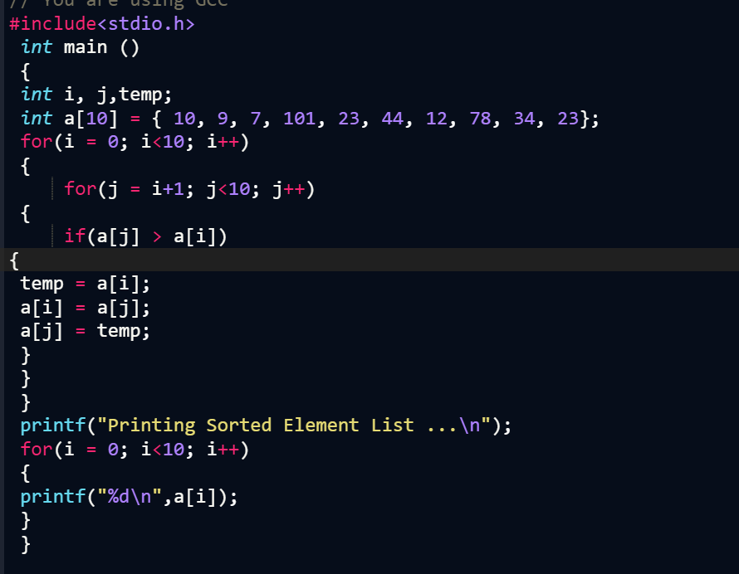

Slide 18
Insertion sort
Insertion sort inserts each item into its proper place in the final list. In insertion sort , the first iteration starts with comparison of 1st element with 0th element. In the second iteration 2nd element is compared with the 0th and 1st element and so on. In every iteration an element is compared with all elements. The main idea is to insert the ith pass the ith element in A[1], A[2]…A[i] in its proper place

Slide 19
Insertion Sort
To insert 12, we need to make room for it by moving first 36 and then 24.
10
24
6
36
12

Slide 20
Insertion Sort
10
24
6
36
12

Slide 21
Insertion Sort
24
6
10
36
12

Slide 22

Insertion Sort
input array
5 2 4 6 1 3
at each iteration, the array is divided in two sub-arrays:
left sub-array
right sub-array
sorted
unsorted

Slide 23





Insertion Sort

Slide 24
Insertion Sort Example
Sort: 34 8 64 51 32 21
34 8 64 51 32 21
  The algorithm sees that 8 is smaller than 34 so it swaps.
8 34 64 51 32 21
  51 is smaller than 64, so they swap.
8 34 51 64 32 21
8 34 51 64 32 21 (from previous slide)
  The algorithm sees 32 as another smaller number and moves it to its appropriate location between 8 and 34.
8 32 34 51 64 21
  The algorithm sees 21 as another smaller number and moves into between 8 and 32.
Final sorted numbers:
8 21 32 34 51 64

Slide 25
Insertion sort
INSERTION_SORT (A, N)(Array starts from O)
Repeat Step 2 to 4 for K = 1, 2, …, N-1:
Set TEMP = A[K] and PTR = K – 1.
Repeat while TEMP < A[PTR] and PTR>=O:
(a) Set A[PTR+1] = A[PTR]
(b) Set PTR = PTR – 1.
[End of Loop.]
Set A[PTR+1] = TEMP.
[End of Loop 2.]
5. Return.

Slide 26
Insertion Sort Complexity
  This Sorting algorithm is frequently used when n is very small.
  Worst case occurs when array is in reverse order. The inner loop must use K – 1 comparisons.
  f(n) = 1 + 2 + 3 + ….+ (n – 1)
  = n(n – 1)/2
= O(n²)
  In average case, there will be approximately (K – 1)/2 comparisons in the inner loop.
  f(n) = (1 + 2 + 3 + ….+ (n – 1))/2
  = n(n – 1)/4
= O(n²)

Slide 27
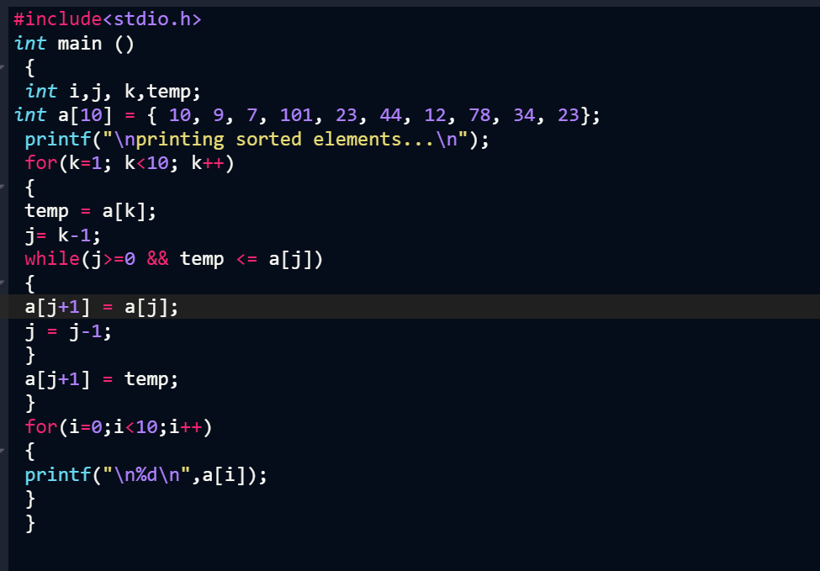

Slide 28
Selection sort
Selection sorting is conceptually the simplest sorting algorithm. This algorithm first finds the smallest element in the array and exchanges it with the element in the first position, then finds the second smallest element and exchange it with the element in the second position, and continues in this way until the entire array is sorted.

Slide 29
Selection Sort
SELECTION SORT(ARR, N)
Step 1: Repeat Steps 2 and 3 for K = 1 to N-1
Step 2: CALL SMALLEST(ARR, K, N, POS)
Step 3: SWAP A[K] with ARR[POS] [END OF LOOP]
Step 4: EXIT
SMALLEST (ARR, K, N, POS)
Step 1: [INITIALIZE] SET SMALL = ARR[K]
Step 2: [INITIALIZE] SET POS = K
Step 3: Repeat for J = K+1 to N
IF SMALL > ARR[J]
SET SMALL = ARR[J]
SET POS = J
[END OF IF]
[END OF LOOP]
Step 4: RETURN POS

Slide 30
Selection Sort Example
8
4
6
9
2
3
1
1
2
3
4
9
6
8
1
4
6
9
2
3
8
1
2
3
4
6
9
8
1
2
6
9
4
3
8
1
2
3
4
6
8
9
1
2
3
9
4
6
8
1
2
3
4
6
8
9

Slide 31
Selection Sort Complexity
The number f(n) of comparisons in selection sort algorithm is independent of original order of elements. There are n-1 comparisons during pass 1 to find the smallest element, n-2 comparisons during pass 2 to find the second smallest element, and so on.
Accordingly,
f (n) = (n-1)+(n-2)+-----+2+1
= n(n-1)/2
= O(n²)
The f (n) holds the same value O(n²) both for worst case and average case.

Slide 32
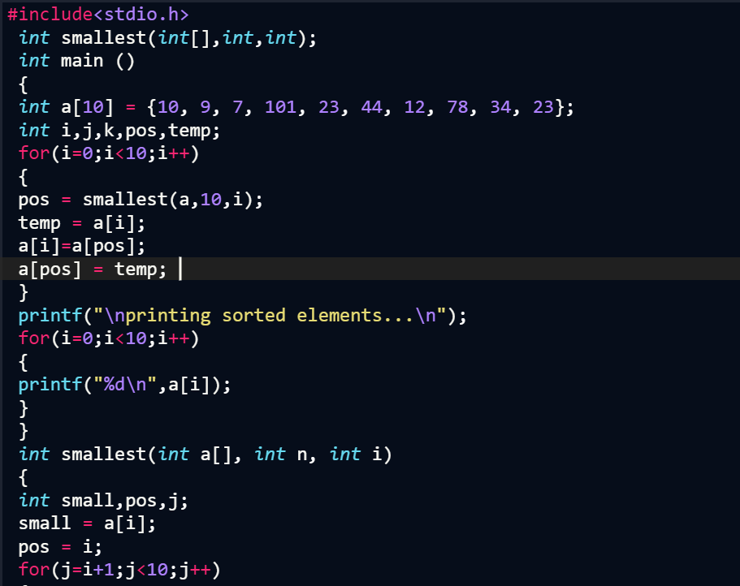

Slide 33
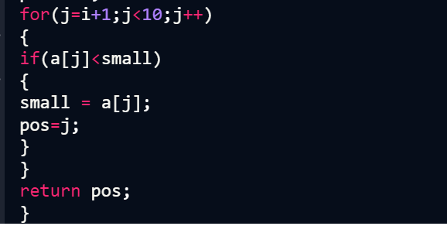
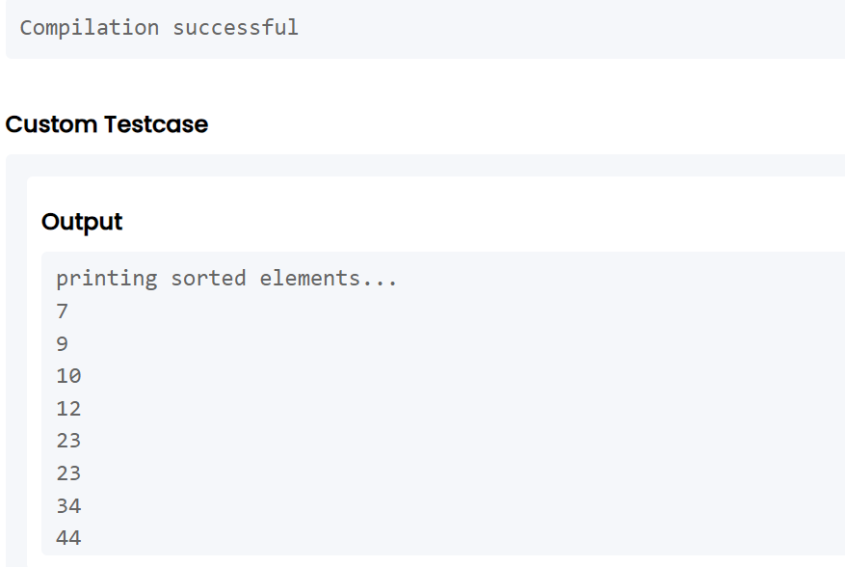

Slide 34
Comparing the Algorithms
        Best Average Worst
        Case Case Case
Bubble Sort O(n) O(n²) O(n²)
Insertion Sort O(n) O(n²) O(n²)
Selection Sort O(n²) O(n²) O(n²)

Slide 35
Thank You

